Slide 1
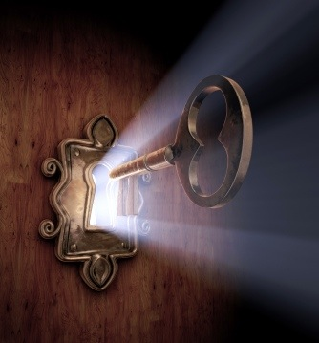
The Seven Keys of Spiritual Wellness:
Tending to your Soul as a Minister
Julianne Stanz
Julianne Stanz

Slide 2
Blessed are those who believe in the Church whom they serve,
for their work will have dedication.
Blessed are those who guide rather than dictate,
for they shall have cooperation.
Blessed are those who respect the opinions of others,
for they shall be admired.

Slide 3
Blessed are those who present their point tactfully,
for they shall succeed.
Blessed are those who search out the facts and ignore the gossip,
for they shall be respected.
Blessed are those who give credit to others, overcoming jealousy,
for they will have willing helpers.

Slide 4
Blessed are those who seek to be humble,
for they have a due share of recognition without looking for it.
Blessed are those who can take orders as well as give them,
for there in lies true leadership.
Blessed are those who in spite of criticism, have the strength
Of purpose to continue and the stamina to carry on,
for they shall be real leaders.
Blessed are those who have faith in their fellow people,
For they themselves are justified.

Slide 5
The SoulFriend Helps You to See Beyond
Today, I begin a holy day
Blessed by the holy Three
Each day a blessing,
Each night a rest,
A dweller in a holy place,
Each day a page,
Each week a chapter
In the hand of God.
Amen.
The judgmental eye
The indifferent eye
The superior eye
The resentful eye
The loving eye
“Many of us have made our world so familiar that we do not see it anymore. An interesting question to ask yourself at night is, What did I really see this day?”

Slide 6
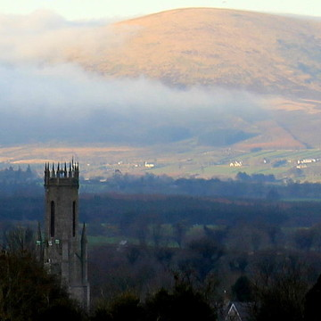

Slide 7
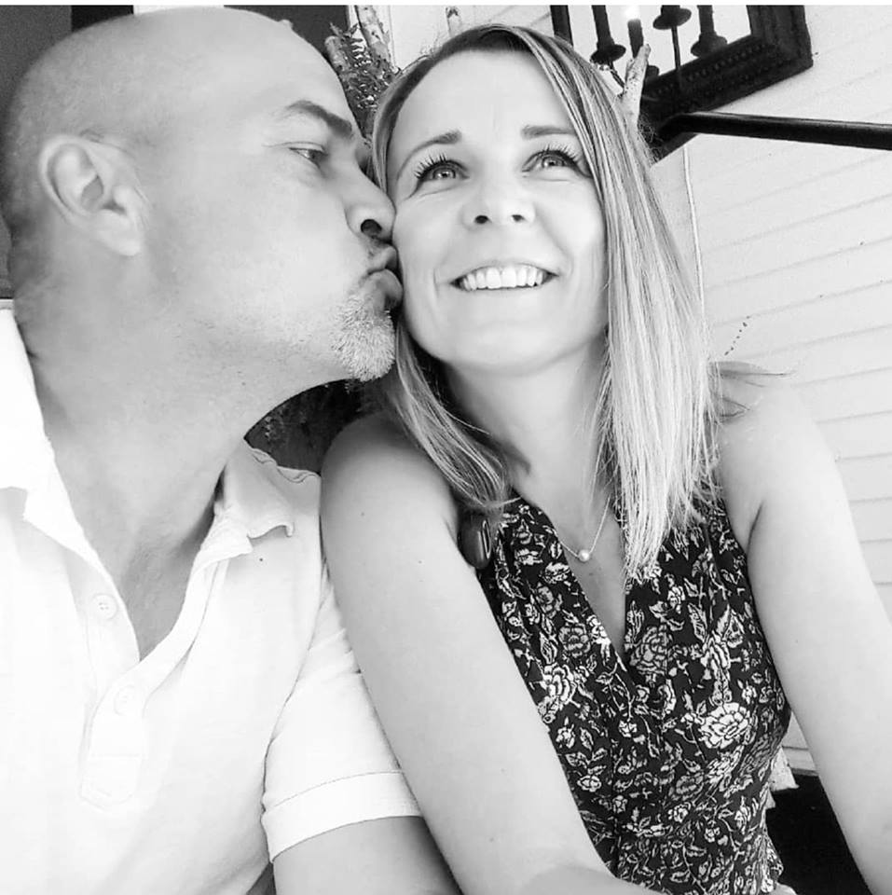
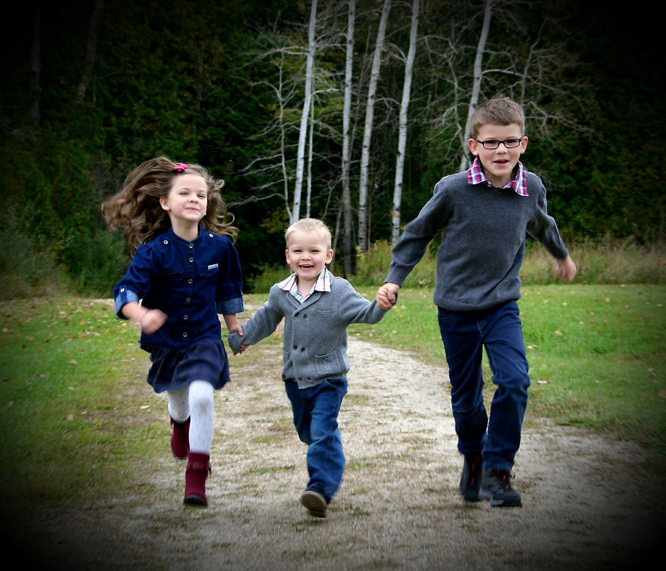
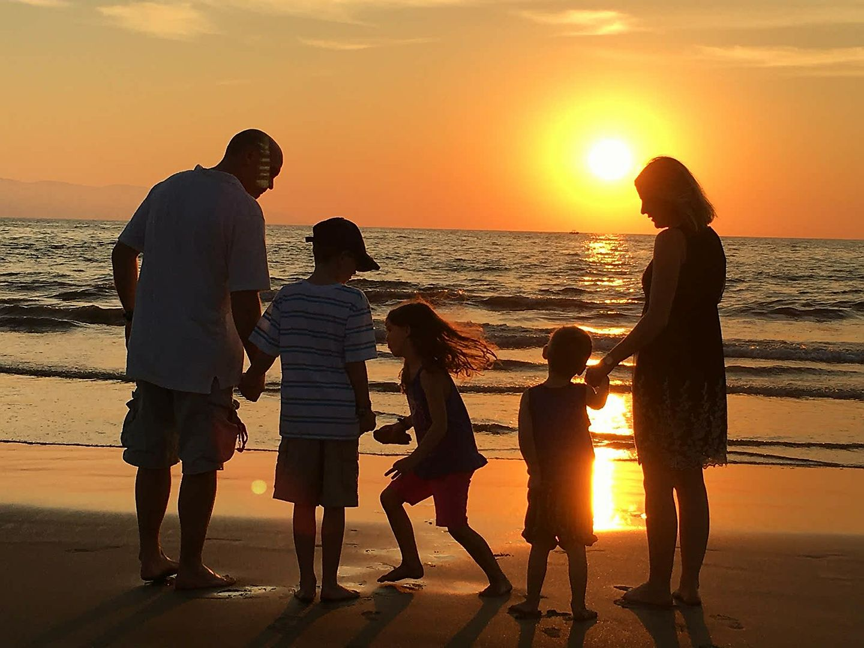

Slide 8
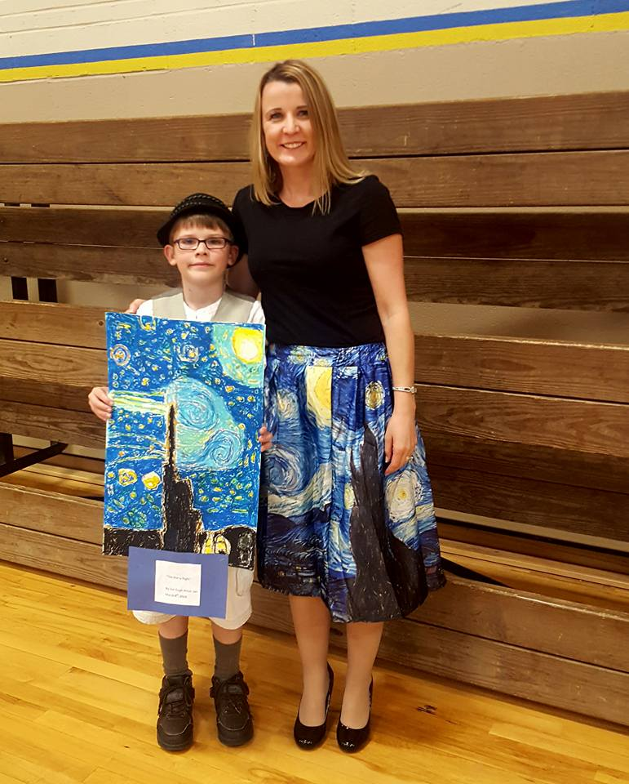
Ian’s Story

Slide 9
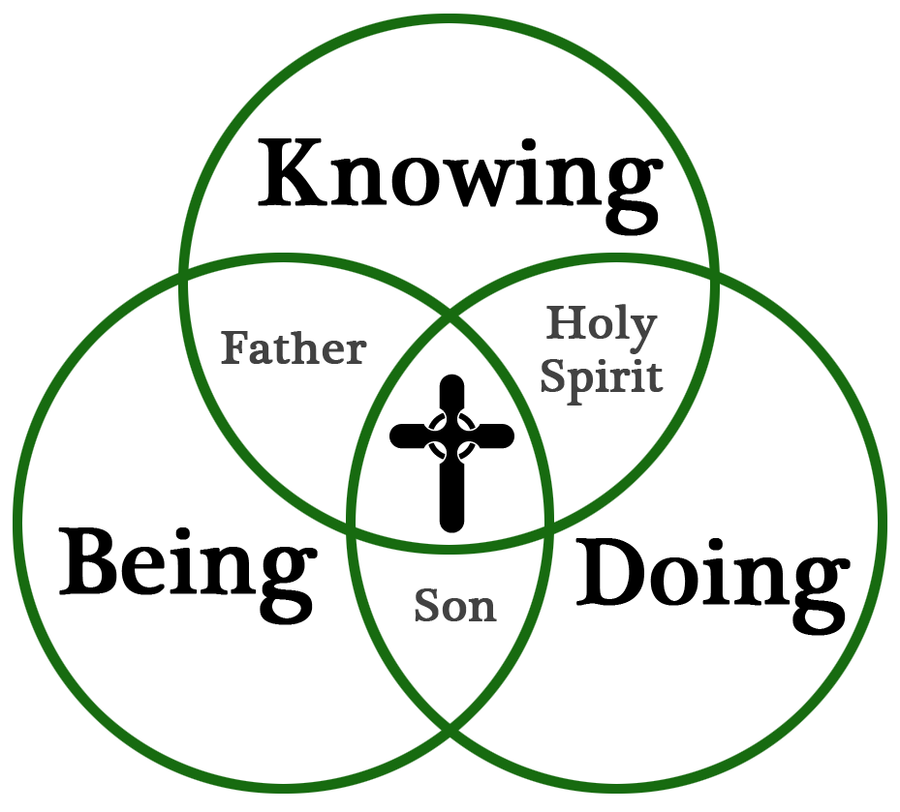
The General Directory for Catechesis tells us that
"diocesan pastoral programs must give absolute priority
to the formation of lay catechists" (234) and that
such formation must include three dimensions:
"being, knowing, and savoir-faire [doing]." (238)

Slide 10
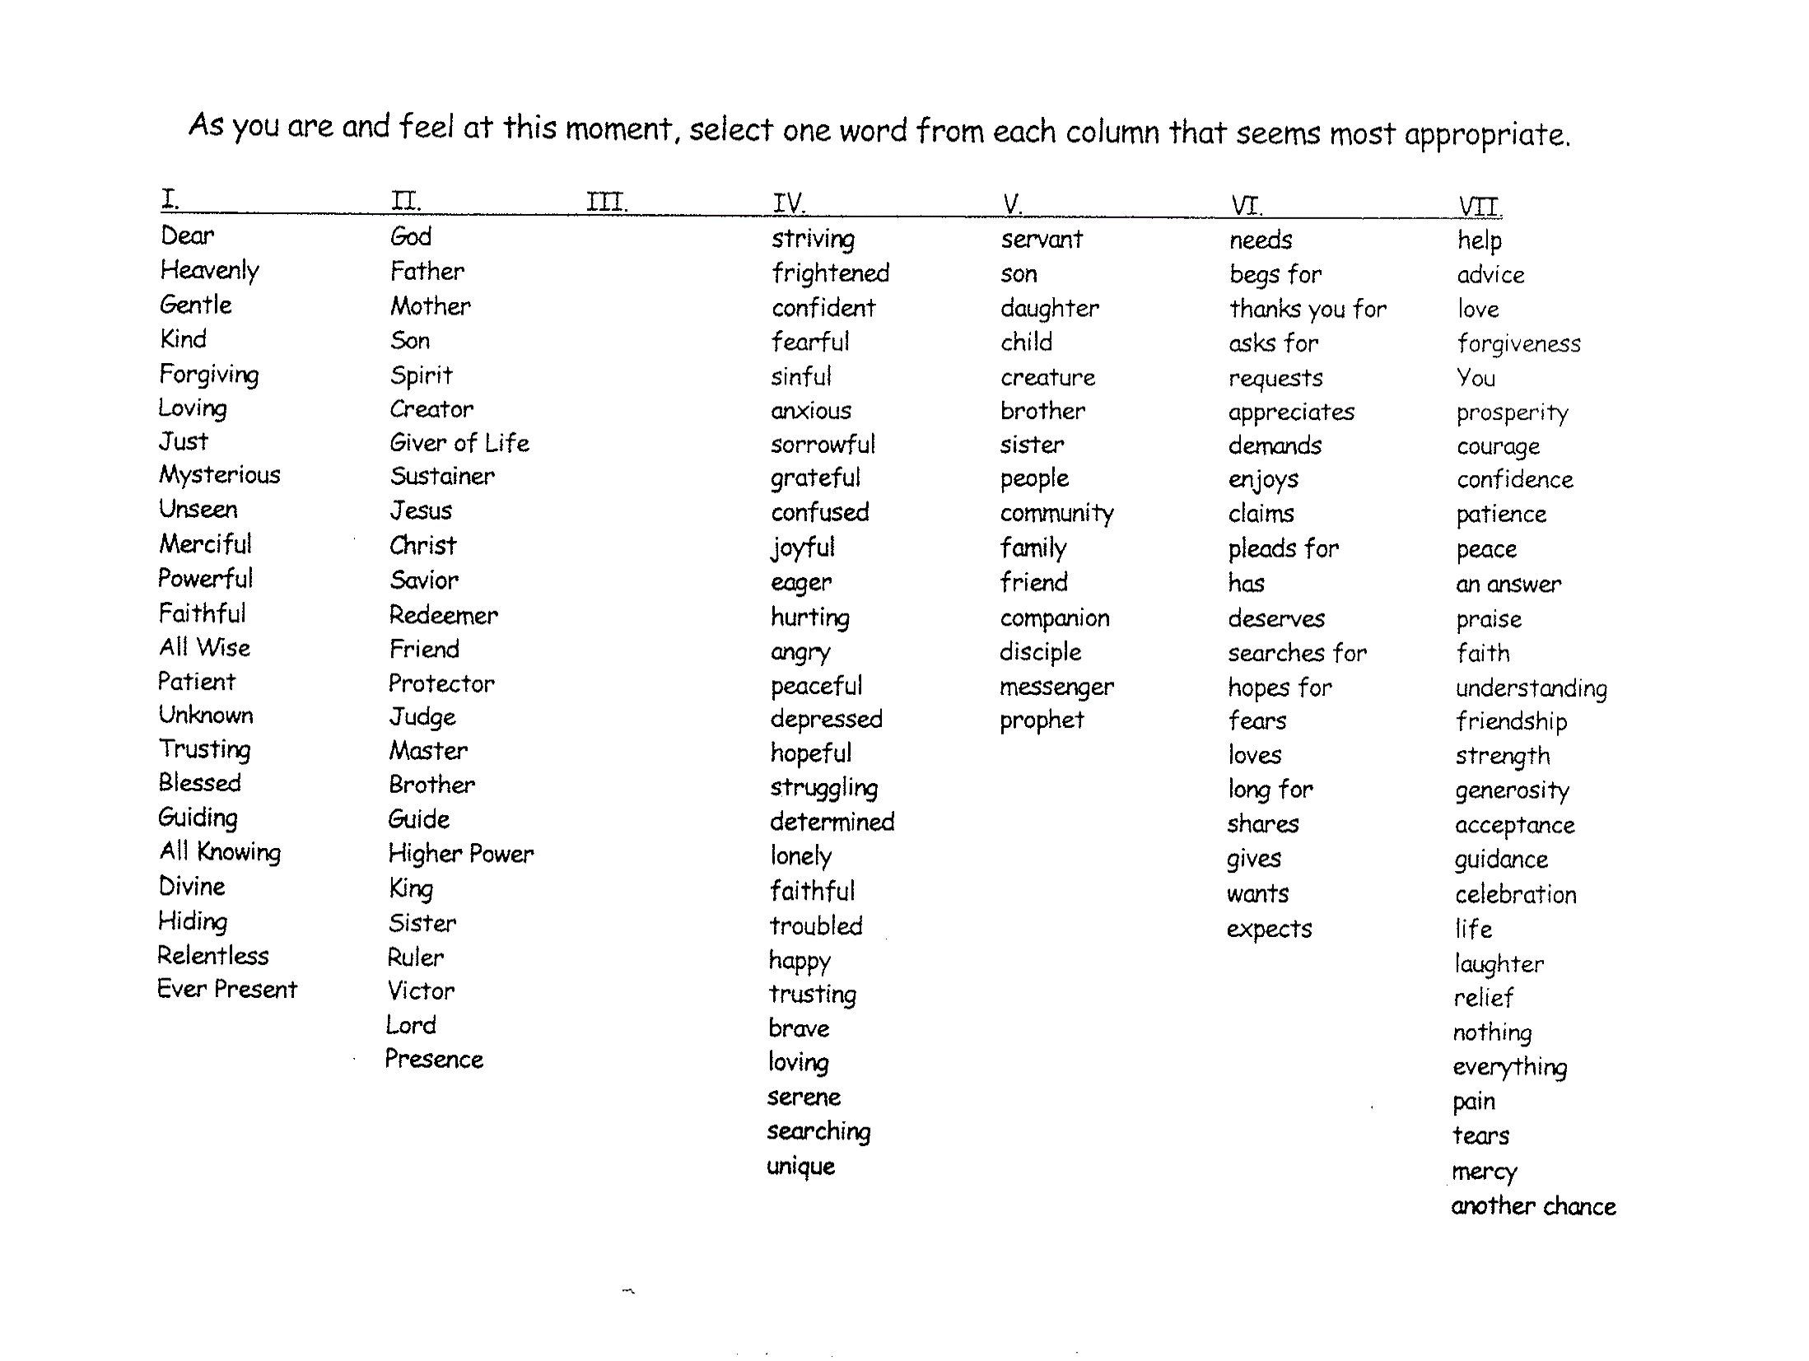

Slide 11
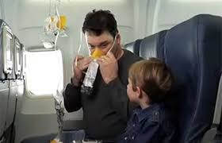

Slide 12
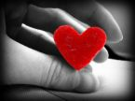
Where you at right now??
If you had to describe your year in one word what would it be?
What would you let go of for a moment in order to feel peaceful right now?
What name can you give to the "restlessness" in your heart?
What are you hoping to take with you from this experience?
Notes:
Opportunity for Sharing and Reflection- Taking stock of where you are, where you have been and where you are going. “Aithri”- Gaelic “Change of Heart/Mind” Pilgrim Beings on the way.

Slide 13
Key 1: Keep Christ at the Heart of Your Life
Key 2: The Deep Breath of Prayer
Key 3- Recognizing what threatens your spiritual health
Key 4- Cultivate an attitude of gratitude
Key 5- Keep a Joyful Heart
Key 6- Share Your Story of Faith
Key 7- Be a Merciful and Healing Presence
Notes:
Review each of the 7 keys briefly as lights on the path to spiritual health.

Slide 14
Key 1-Keep Christ at the Heart of Your Life
Julianne Stanz

Slide 15
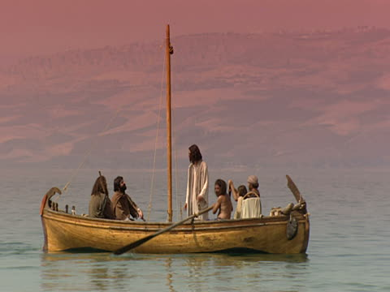

Slide 16
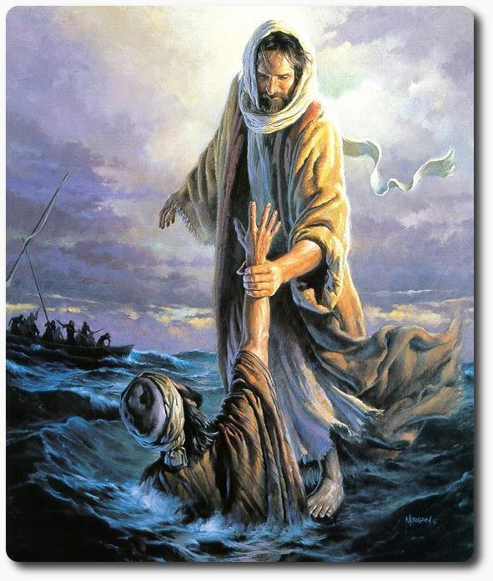
We follow jesus as His disciples by Sharing Our Story of faith

Slide 17
The Paradox of Our Time in History is that
we spend more, but have less; we buy more, but enjoy it less. We have bigger houses and smaller families; more conveniences, but less time; more medicine, but less wellness. We read too little, watch TV too much, and pray too seldom. We have multiplied our possessions, but reduced our values.
These are the times of tall men, and short character; steep profits, and shallow relationships. These are the days of two incomes, but more divorce; of fancier houses, but broken homes.
We've learned how to make a living, but not a life; we've added years to life, not life to years; we've cleaned up the air, but polluted the soul.
Anonymous
Where do you see this in your ministry? In your own life?
Notes:
Let’s look at the culture- we clearly have a hunger for Holiness- In an age of plenty- we are spiritually bankrupt. What resonates with you? Do you find seeds of truth in this? What assumptions would you challenge?
Let’s look at 3 issues- materialism, individualism and hedonism from a slightly different perspective- the pragmatic, narcissism, restlessness.

Slide 18
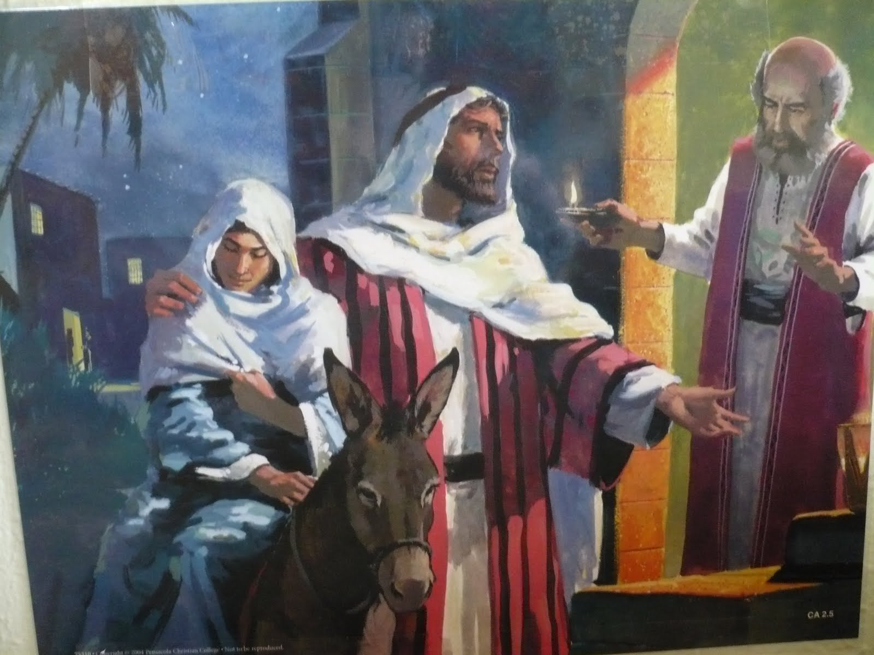
She wrapped him in cloths and placed him in a manger, because there was no guest room available for them.
Luke 2:1-7

Slide 19
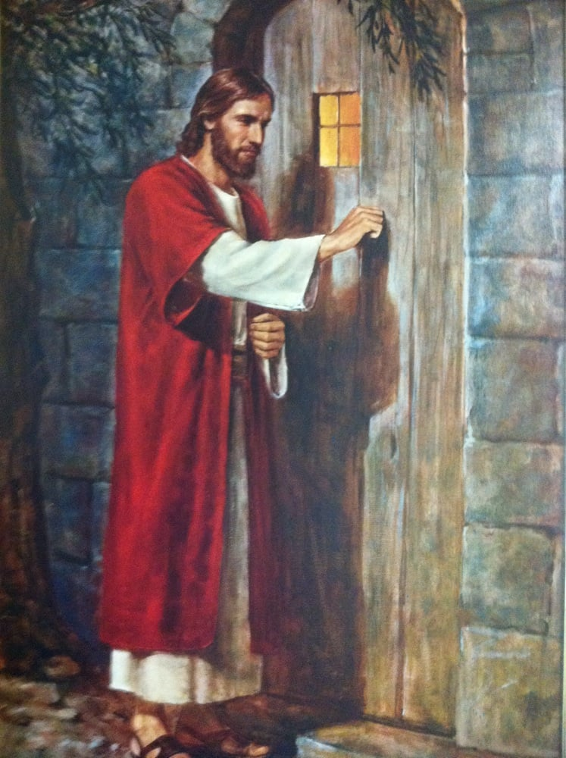

Slide 20
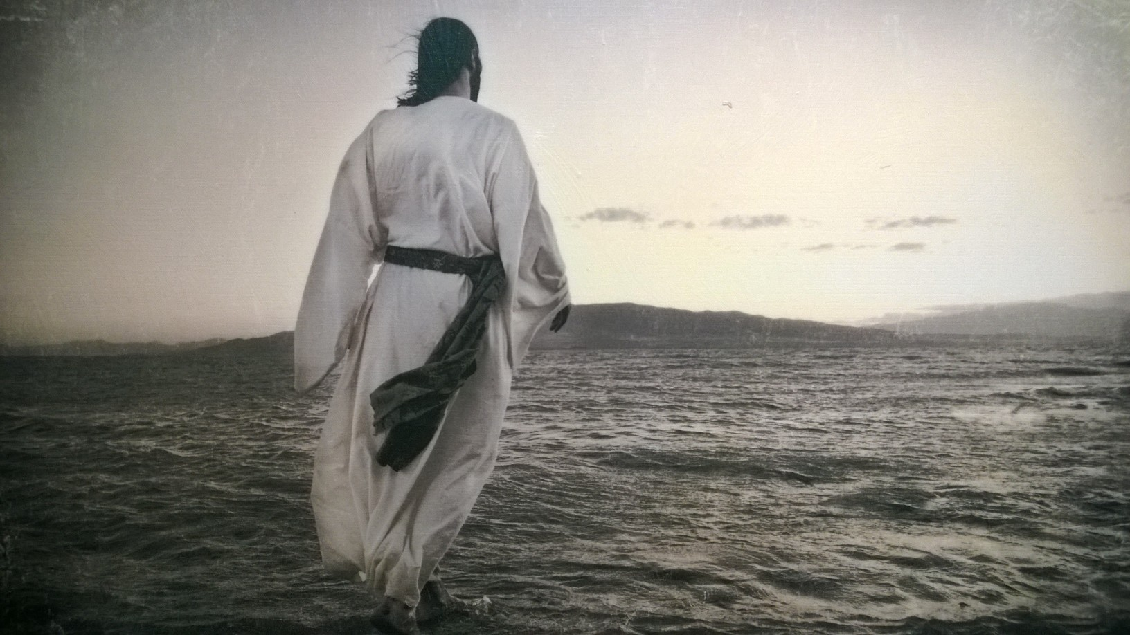
The question posted by a newspaper “What is wrong with the world?” was answered by Catholic author and writer G.K Chesterton as follows:
“Dear Sirs:
I am.
Sincerely Yours,
G. K. Chesterton.”

Slide 21
Disciples, not Admirers

Slide 22
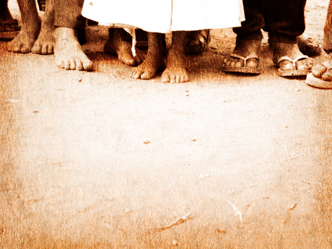
Follow Jesus: The Way of Discipleship

Slide 23
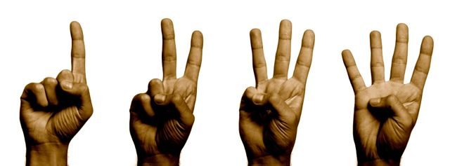
1. We are Disciples of a Person.
2. We are not teaching a “subject” but introducing people to a Mystery.
3. Disciples make disciples.
4. You can only lead others as far as you have gone yourself as a disciple.

Slide 24
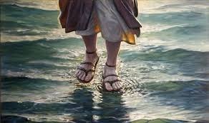
The word disciple comes from the Greek word mathetes meaning pupil/student of the master. The Master is of course, Jesus Christ.
.

Slide 25
“The definitive aim of catechesis is to put people not only in touch but in communion, in intimacy with Jesus Christ: only he can lead us to the love of the Father in the Spirit and make us share in the life of the Holy Trinity”.
St. John Paul II, Catechesi Tradendae, (On Catechesis in Our Time, 1979, no. 5)

Slide 27
Stage | Pre-Evangelization | Evangelization | Discipleship | Missionary Discipleship
Pope Francis Emphasis | Encounter | Accompaniment | Community | Mission
Methodology | Relationship Building Sharing My Story Questions & Answers Healing Hospitality Service Opportunities (personal) | Proclamation Encounter with Christ New Apologetics Witness/Testimony Gift Inventories/Discernment | Catechesis (Initial/ Post-Baptismal/ Continuing) Charism Discernment Sacramental/ Liturgical | Ongoing formation Apostolic Leadership Service (transformation of communal life)
Scripture | Come and See | Follow Me | Remain United With Me | Go and Make Disciples

Slide 28
“An arrow aimed at the head, will not pierce the heart”.
An Arrow Aimed at the Head Will Not Pierce the Heart

Slide 29
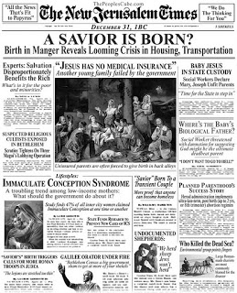

Slide 30
Key 1: Keep Christ at the Heart of Your Life
Key 2: The Deep Breath of Prayer
Key 3- Recognizing what threatens your spiritual health
Key 4- Cultivate an attitude of gratitude
Key 5- Keep a Joyful Heart
Key 6- Share Your Story of Faith
Key 7- Be a Merciful and Healing Presence
Notes:
Review each of the 7 keys briefly as lights on the path to spiritual health.

Slide 31
Key 2- The Deep Breath of Prayer
Julianne Stanz

Slide 32
Your GPSS- Global Positioning Spiritual System

Slide 33
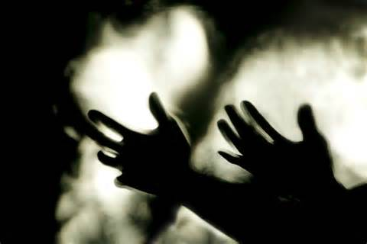
Prayer is essential for Evangelization because Christian preaching is not primarily the communication of doctrine, but rather the communication of existence, of a life.
The one who prays without speaking evangelizes more than the one who speaks without praying.
Cantalamessa, 34

Slide 34
The Presence of God
Lord Jesus Christ (breathe in)
Son of the living God (breathe out)
Have mercy on me (breathe in)
a sinner. (breathe out)
Lord Jesus Christ
Son of the living God
Have mercy on me
a sinner.

Slide 35
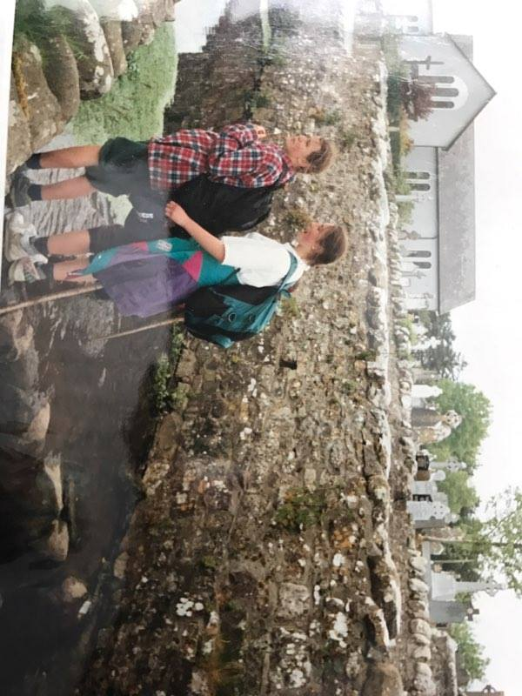
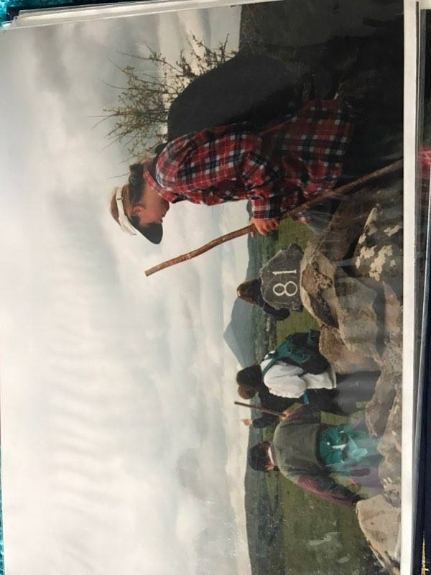
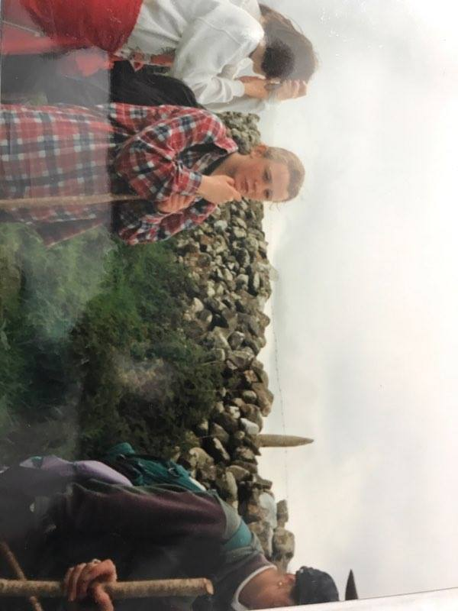
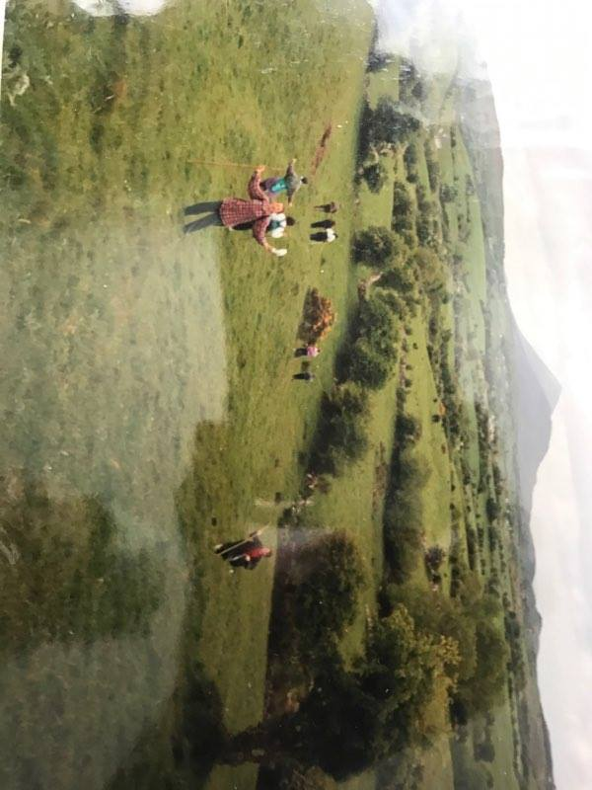

Slide 36
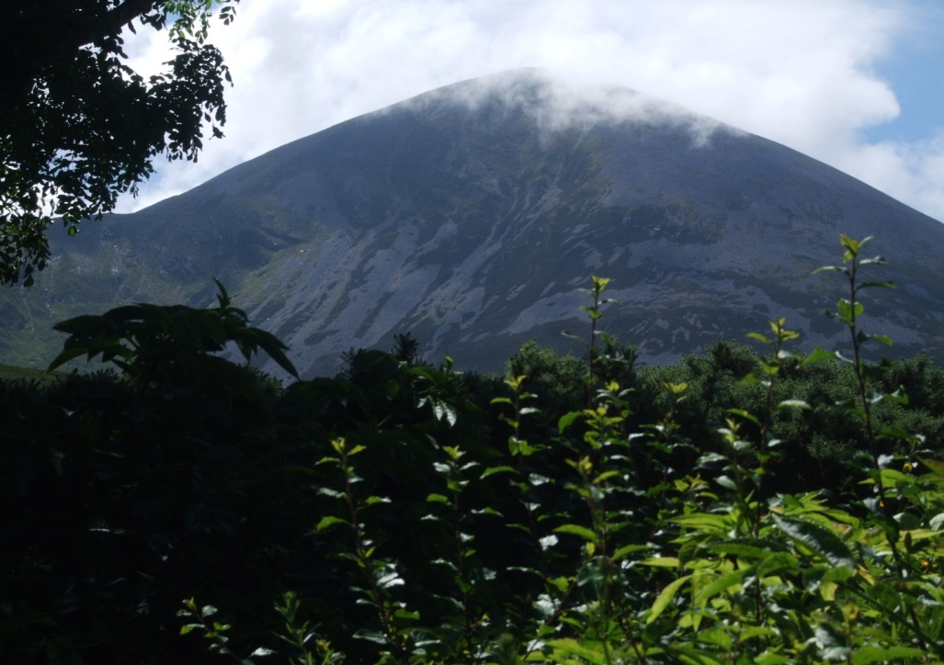

Slide 37
Share Prayer
You can call on God the following ways: God, Lord, Father, Jesus, Holy Spirit, etc.
Thank God for the person you are praying with and ask for God's blessing upon them: "Thank you for Francis, you son. Please bless him."
Then ask God for what the person needs: "Heal Francis' grandmother. Help Francis' family to make the right decisions about the nursing home. Continue to give Francis and his grandmother a wonderful relationship."
Finish the prayer with a doxology: "We ask this through Christ our Lord." OR "We ask this in Jesus' name." OR "Through Our Lord Jesus Christ you Son, who lives and reigns with the Holy Spirit, one God forever and ever." OR etc

Slide 38
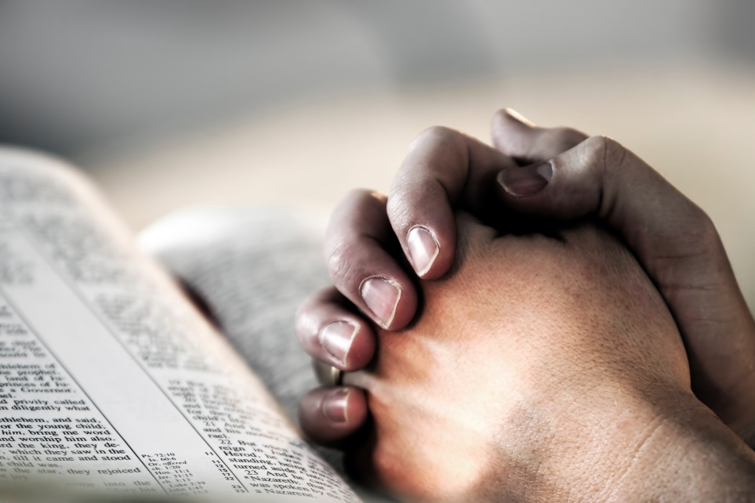
Share prayer practice

Slide 39
Key 3: Recognizing Threats to Our Spiritual Health
Julianne Stanz

Slide 40
Threats to our Spiritual Health
Spiritual Worldliness
Spiritual Sloth
(Narcissism, Pragmatism, Restlessness)

Slide 41
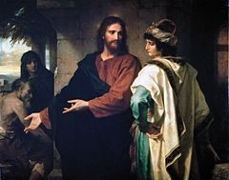
Spiritual Worldliness
“Spiritual worldliness, which hides behind the appearance of piety and even love for the Church, consists in seeking not the Lord’s glory but human glory and personal well-being.” (EG, 93)
John 5:44 - “How can you believe, who receive glory from one another and do not seek the glory the comes from only God?”
Notes:
Image: Icon of the Publican and the Pharisee

Slide 42
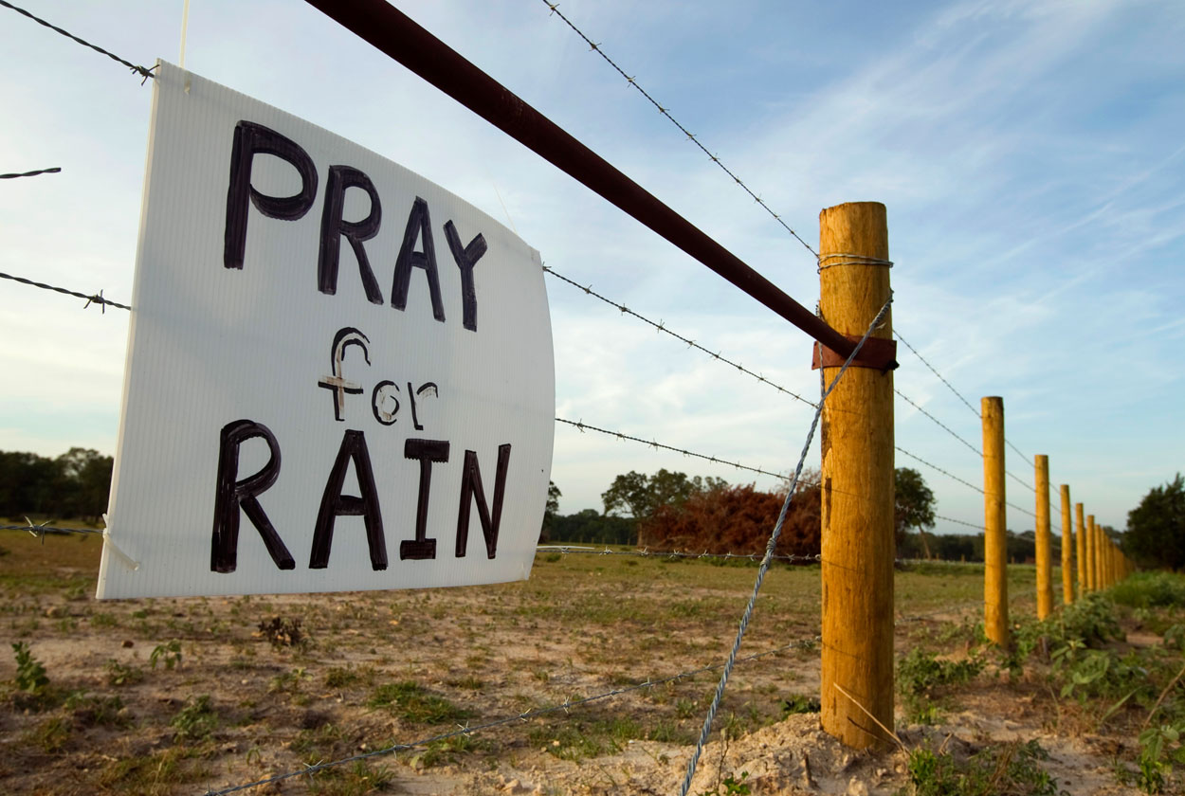
Spiritual Sloth
“The problem is not always an excess of activity, but rather activity undertaken badly, without adequate motivation, without a spirituality which would permeate it and make it pleasurable. As a result, work becomes more tiring than necessary, even leading at times to illness.” (EG, 82)
*Praying for Rain*

Slide 43
All Business…..The Pragmatic
Greek “pragma”- business
Our sense of worth comes from what we do
Doing accounts for everything, being for nothing
The Scientific is preferred
“With too little time for sleep, there is little time to dream”
Notes:
Headache

Slide 44
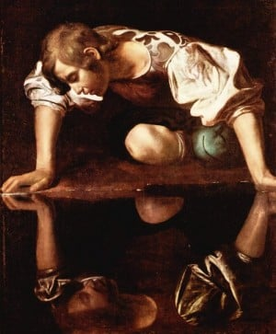
Narcissism
The incapacity to Recognize Sufficiently the Reality of others
The “Yuppie” Phenomenon
The Movement towards Excessive Privacy
Notes:
Heartache. Tie opening statement into spiritual key #2
Relativism, Materialism, Individualism- emphasizedquality of life, upward mobility, the pursuit of excellence, material comfort.

Slide 45
Unbridled Restlessness
Nothing seems good enough for us
Greed for experience
The Loss of Interiority
“the unexamined life is not worth living”
Socrates
Notes:
Insomnia- Our hearts are restless…..St. Augustine

Slide 46
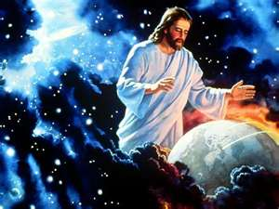
“I have told you these things, so that in me you may have peace. In this world you will have trouble. But take heart! I have overcome the world.” John 16:33
Notes:
Peace and Joy- are both marks of a person alive with the Holy Spirit.
What the world defines
Money
What we do
What we have
How we appear- realty tv
Christ- language of Christ is silence
Drowned out by noise of culture
Faithful- what about soul

Slide 47
The 15 Diseases of Pastoral Ministers

Slide 48
Key 1: Keep Christ at the Heart of Your Life
Key 2: The Deep Breath of Prayer
Key 3- Recognizing what threatens your spiritual health
Key 4- Cultivate an attitude of gratitude
Key 5- Keep a Joyful Heart
Key 6- Share Your Story of Faith
Key 7- Be a Merciful and Healing Presence
Notes:
Review each of the 7 keys briefly as lights on the path to spiritual health.

Slide 49
Key 4- Cultivate an attitude of gratitude
Notes:
Review each of the 7 keys briefly as lights on the path to spiritual health.

Slide 50
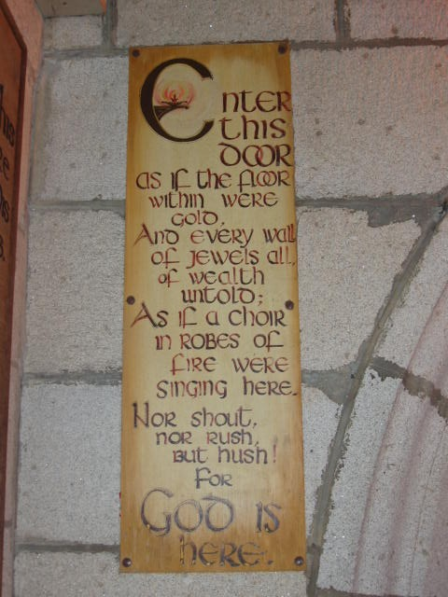
Plaque from door of Church in Graigecullen, Co. Carlow
Notes:
Value of the silence…..Church can be an oasis of peace in a jungle of chaos…

Slide 51
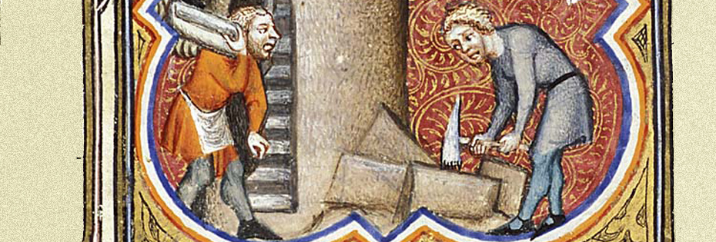
What Are You Building?
There is a story set in medieval times that tells of a traveler who comes upon three stonemasons. He asks each in turn: ‘What are you doing?’ The first answers, without hesitation, ‘I am cutting this stone.’ The second, who appears to be doing the identical job makes a gesture with his hand and says; ‘I am completing the wall.’ The third, again seems to be doing the same job slowly raises his eyes to the sky and says; ‘I am building a cathedral.’

Slide 52
They were all doing the same thing. The first man had a job. The second man had a career. The third man had a calling. Do you feel called by God to be where you are? What are you building?

Slide 53
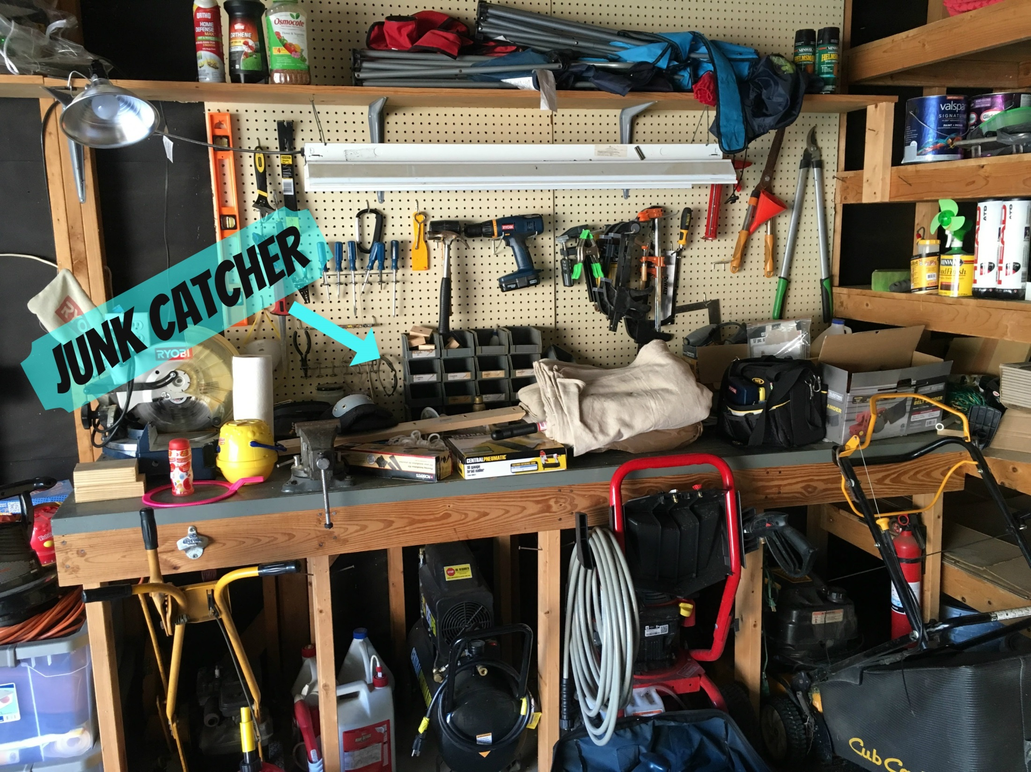

Slide 54
Key 1: Keep Christ at the Heart of Your Life
Key 2: The Deep Breath of Prayer
Key 3- Recognizing what threatens your spiritual health
Key 4- Cultivate an attitude of gratitude
Key 5- Keep a Joyful Heart
Key 6- Share Your Story of Faith
Key 7- Be a Merciful and Healing Presence
Notes:
Review each of the 7 keys briefly as lights on the path to spiritual health.

Slide 55
Key 5-Keep a Joyful Heart
Julianne Stanz

Slide 56
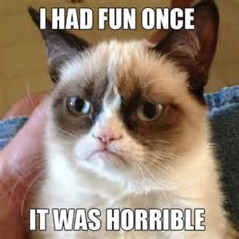
The Pickled Pepper
"Don't wear a cross around your neck if all you're going to do is complain about the one on your back."
- Pope Francis
Notes:
Sticker Ministry

Slide 57
A journey of 18 inches

Slide 58
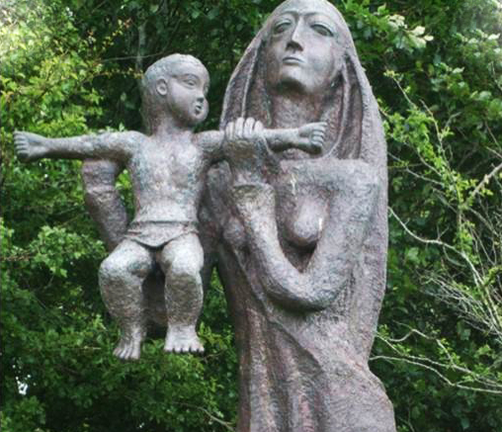

Slide 59
Notes:
The Holy Family- from St. Nicholas Cathedral in Ireland….note Jesus making his mother a cup of tea! In Ireland…..we see things a little differently….the Holy Family are portrayed differently as this image shows.

Slide 60
Social Media Christmas

Slide 61
What is your greatest joy in life? In ministry? Is- what is God calling you to and what the Church is asking of you, the same for you?

Slide 62
Key 1: Keep Christ at the Heart of Your Life
Key 2: The Deep Breath of Prayer
Key 3- Recognizing what threatens your spiritual health
Key 4- Cultivate an attitude of gratitude
Key 5- Keep a Joyful Heart
Key 6- Share Your Story of Faith
Key 7- Be a Merciful and Healing Presence
Notes:
Review each of the 7 keys briefly as lights on the path to spiritual health.

Slide 63
Key 6: Share Your Story of Faith
Julianne Stanz

Slide 64
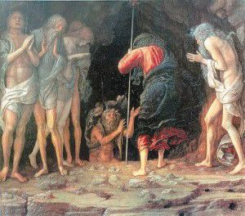
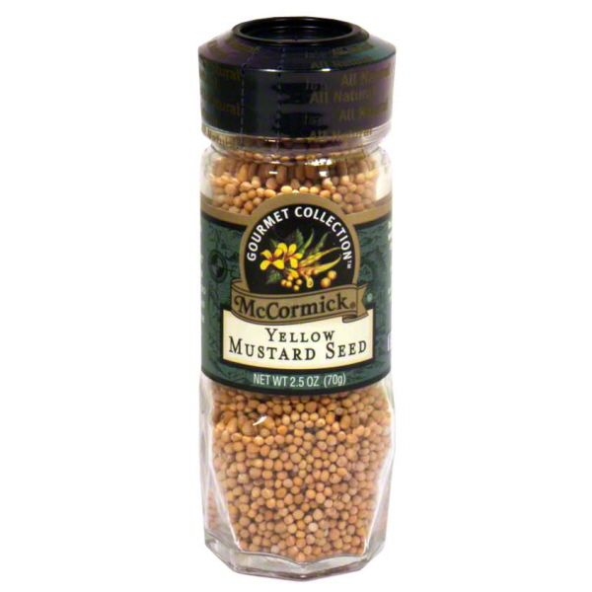
Nick’s Story

Slide 65
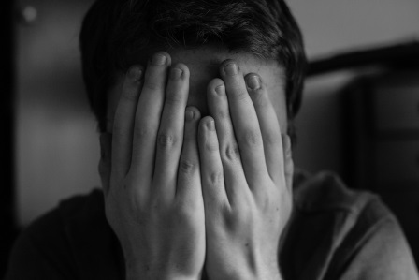
I was. God did. I am.

Slide 66
Key 1: Keep Christ at the Heart of Your Life
Key 2: The Deep Breath of Prayer
Key 3- Recognizing what threatens your spiritual health
Key 4- Cultivate an attitude of gratitude
Key 5- Keep a Joyful Heart
Key 6- Share Your Story of Faith
Key 7- Be a Merciful and Healing Presence
Notes:
Review each of the 7 keys briefly as lights on the path to spiritual health.

Slide 67
Key 7: Be a Merciful and Healing Presence
Julianne Stanz

Slide 68
“The thing the church needs most today is the ability to heal wounds and to warm the hearts of the faithful….I see the church as a field hospital after battle. It is useless to ask a seriously injured person if he has high cholesterol and about the level of his blood sugars! You have to heal his wounds. Then we can talk about everything else. Heal the wounds, heal the wounds. ...
From “A Big Heart Open to God,” America magazine Sept. 19, 2013.

Slide 69
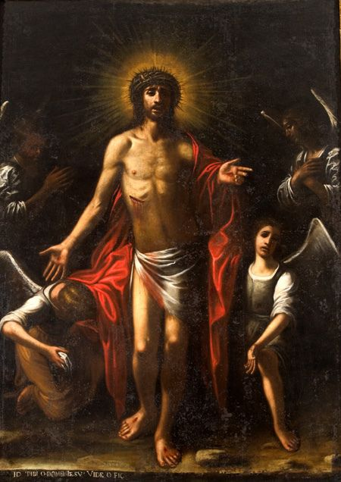
Mario Minniti,
The Five Wounds of Christ
Notes:
The first thing the risen Jesus did is to show his wounds.

Slide 70
How do you respond?
THE INCOME TAX MAN asked if he was paying taxes on the pit.
A SELF-PITYING PERSON said, “You haven’t seen anything until you have seen my pit.”
AN OPTIMIST said, “Things could get worse.”
A PESSIMIST said, “Things will get worse.”

Slide 71
How do you respond?
A man fell into a pit and could not get himself out:
A SUBJECTIVE PERSON said, “I feel for you down there.”
AN OBJECTIVE PERSON said, “How could someone possibly fall down there?”
A PHARISEE said, “Only bad people would fall into a pit.”
A NEWS REPORTER wanted an exclusive story on the pit.
A MATHEMATICIAN calculated how he fell into the pit.
Notes:
Anais Nin- we see the world, not as it is but as we are.

Slide 72
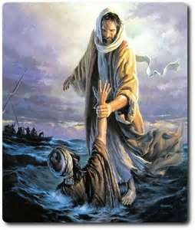
JESUS, seeing the man, took him by the hand, and lifted him up out of the pit.
Notes:
Be present, see every moment as an opportunity to encounter Christ and lead others to Him.

Slide 73
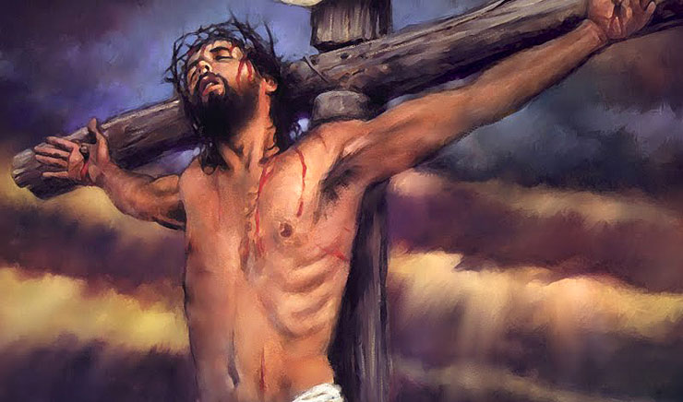

Slide 74
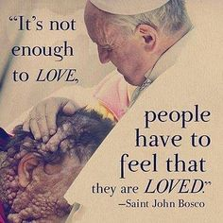
Notes:
Share homeless story

Slide 75
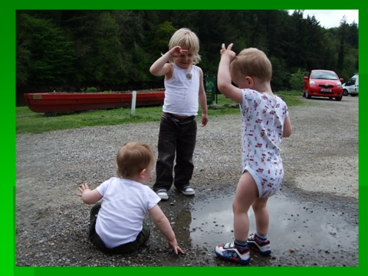

Slide 76
The Wyoming Prayer
“Lord, help me to do your will.
Nothing more, nothing less.
Lord, help me to do your will.
Not a moment sooner.
Not a moment later.
Than You will it.”

Slide 77
Questions? Comments?
Contact me at:
Julianne Stanz
jstanz@gbdioc.org
Gurbh Mile Maith Agait (A Hundred Thousand Thank Yous)

